Slide 1
Creating a Physical Standby Database by Using Enterprise Manager Grid Control

Slide 2
Objectives
After completing this lesson, you should be able to:
  Use Enterprise Manager to create a broker configuration
  Use Enterprise Manager to manage the broker configuration

Slide 3




Using Oracle Enterprise Manager to Create a Broker Configuration
  Use the Add Standby Database Wizard to:
    Create a broker configuration
    Create a standby database
    Add a database to a broker configuration
  Primary database must be started with a server parameter file (SPFILE).
Notes:
Using Enterprise Manager to Create a Broker Configuration
Oracle Enterprise Manager (Enterprise Manager) automates the process of creating a standby database. The Add Standby Database Wizard is used to create a new broker configuration (including standby databases) and to add databases to an existing configuration.
Before you invoke the Add Standby Database Wizard, verify that the primary database instance was started with a server parameter file (SPFILE). If the instance was not started with an SPFILE, the wizard notifies you.

Slide 4
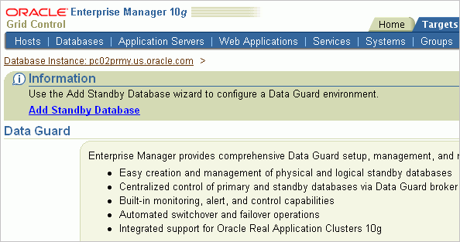
Creating a Configuration
Click Add Standby Database
to start the wizard.
Notes:
Oracle Database 11g: Data Guard Administration 5 - <number>
Creating a Configuration
You can access the Data Guard features in Enterprise Manager Grid Control by clicking “Setup and Manage” in the Data Guard section on the Maintenance page.
Click the Add Standby Database link to invoke the Add Standby Database Wizard.

Slide 5
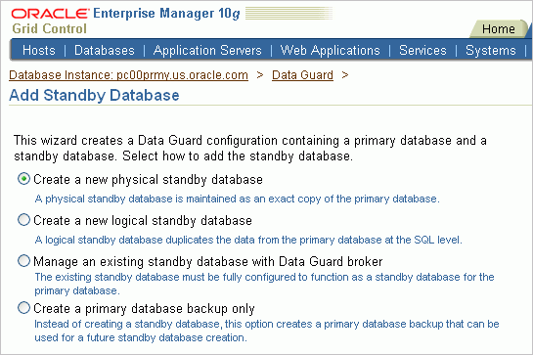
Creating a New Configuration
Notes:
Oracle Database 11g: Data Guard Administration 5 - <number>
Creating a New Configuration
Using the Add Standby Database Wizard, perform the following steps:
1. Specify the backup type to use for the standby database creation.
2. Specify the backup options.
3. Select the Oracle home in which to create the standby database.
4. Specify the location for standby database files.
5. Specify standby database configuration parameters.
6. Review the configuration information.
During the standby creation process, the following operations are performed:
The control file, data files, and archived redo log files are backed up to a temporary location on the primary host.
The backup pieces from the primary host are transferred to a temporary location on the standby host.
Additional required files (such as initialization parameter and password) are created on the standby host.
The control file, data files, and archived redo log files are restored to the specified locations on the standby host.
Online log files and other files are added to the standby database as needed.
The recovered database is changed into a physical or logical standby.

Slide 6
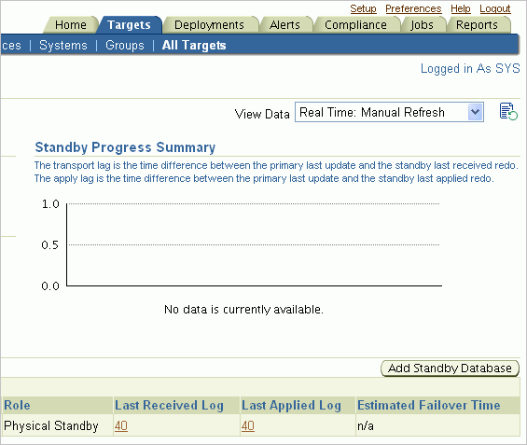
Adding a Standby Database to an Existing Configuration
Click Add Standby Database
to start the wizard.
Notes:
Oracle Database 11g: Data Guard Administration 5 - <number>
Adding a Standby Database to an Existing Configuration
Click the Add Standby Database button to invoke the Add Standby Database Wizard.

Slide 7
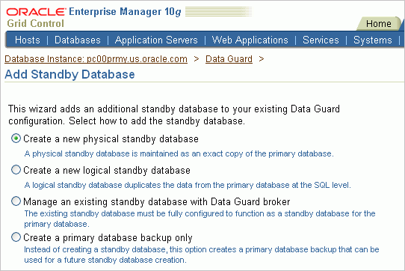
Using the Add Standby Database Wizard
Notes:
Oracle Database 11g: Data Guard Administration 5 - <number>
Using the Add Standby Database Wizard
With the Add Standby Database Wizard, you first select the type of standby database that you want to create. You can create a physical or logical standby database, or you can add an existing database, including a RAC database, to the configuration to serve as a standby database.
Note: You must be connected to the primary database with SYSDBA credentials to invoke the Add Standby Database Wizard.
If you choose to create a new standby database, the following conditions are verified when you click Continue:
All databases in the configuration are using an SPFILE.
The primary database is in ARCHIVELOG mode.
If any of these conditions are not met, the wizard returns a message indicating that you must cancel the wizard and perform the appropriate action to meet the condition.
In addition, the wizard verifies that the primary database is in FORCE LOGGING mode. If it is not, a warning message appears. You can then cancel the configuration and enable FORCE LOGGING.
The following slides describe the wizard steps in detail.

Slide 8
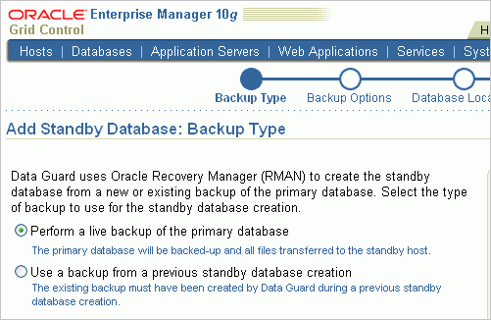
Step 1: Specify the Backup Type
Notes:
Oracle Database 11g: Data Guard Administration 5 - <number>
Step 1: Specify the Backup Type
You can use the Backup Type page of the wizard to select the type of backup for creation of the standby database. There are two options:
Perform a live backup of the primary database: Creates a backup using the Recovery Manager utility (RMAN)
Use a backup from a previous standby database creation: Uses an existing backup of the primary database that was created by Data Guard during a previous creation of a standby database

Slide 9
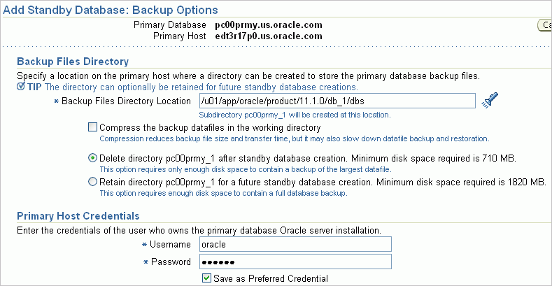
Step 2: Specify the Backup Options
Notes:
Oracle Database 11g: Data Guard Administration 5 - <number>
Step 2: Specify the Backup Options
If you selected the “Perform a live backup of the primary database” option on the Backup Type page, you can specify a location on the primary database host to store the backup files. A default location is specified in the Backup Files Directory Location field, or you can provide your own location. A unique subdirectory to store the backup files is created in the specified directory.
If you intend to create additional standby databases, you can save the backup by selecting the “Retain directory for a future standby database creation” option. Otherwise, you should select the “Delete directory after standby database creation” option. If you choose to retain the backup, additional space is required (as indicated on the Backup Options page).
If you selected the “Use a backup from a previous standby database creation” option on the Backup Type page, specify the location of the backup in the Backup Files Directory Location field. This backup must have been taken by Data Guard during creation of a previous standby database and must be of the same type that you are creating.
In the Primary Host Credentials section, specify the operating-system credentials of the user who owns the primary database Oracle server installation. The credentials are preset to the host-preferred credentials that are stored with the primary database-preferred credentials by default.

Slide 10
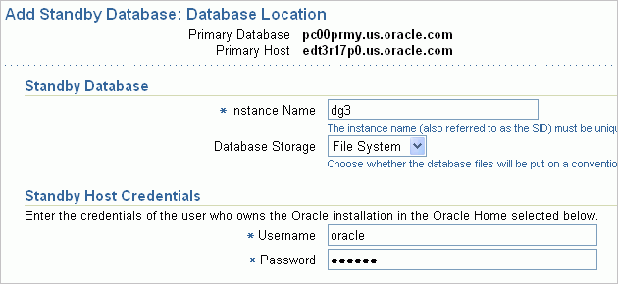
Step 3: Select the Standby Database Location Instance Name
Notes:
Oracle Database 11g: Data Guard Administration 5 - <number>
Step 3: Select the Standby Database Location Instance Name
In the Instance Name field, specify the instance name for your new standby database, or use the default instance name that is provided. The instance name must conform to Oracle naming guidelines.
Note: For a physical standby, the database name is the same as the primary because a physical standby is an exact, block-by-block copy of the primary. You can make the instance name the same as the primary. However, you must make the instance name different from the primary if the standby is on the same machine as the primary.
In the Standby Host Credentials section, specify the operating-system credentials of the user who owns the Oracle installation in the selected Oracle home on the standby host.

Slide 11
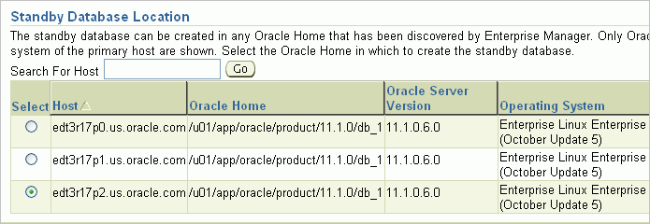
Step 3: Select the Standby Database Location Oracle Home
Notes:
Oracle Database 11g: Data Guard Administration 5 - <number>
Step 3: Select the Standby Database Location Oracle Home
The Standby Database Location section lists all available Oracle homes that match the primary database version and host operating system. From this list, select the host and Oracle home for your new standby database.

Slide 12
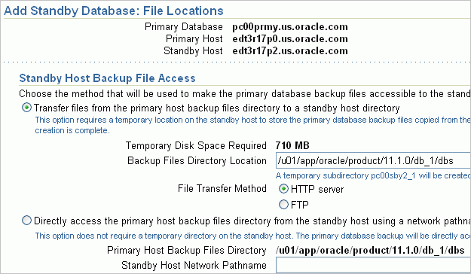
Step 4: Specify the Standby Database
File Locations Access Method
Notes:
Oracle Database 11g: Data Guard Administration 5 - <number>
Step 4: Specify the Standby Database File Locations Access Method
The Standby Host Backup File Access section appears only when you are creating a standby database on a host other than the primary database. You must select a method to be used to make the primary backup files accessible to the standby host.
Transfer files: If you choose to transfer files from the primary host working directory to a standby host directory, you must specify a temporary location on the standby host to store the backup files copied from the primary host. In addition, you must select the file-transfer method: FTP or HTTP server. FTP is the faster of the two methods. Select the “HTTP server” option if you know that the primary or standby host does not support FTP.
Directly access the files: If you select this method, you must supply the network path name for the standby host. This method is appropriate when the primary host working directory location is directly accessible from the standby host via NFS, a network share, or some other network method. This option saves time and disk space because there is no file transfer to the standby host and because no temporary location is needed.

Slide 13
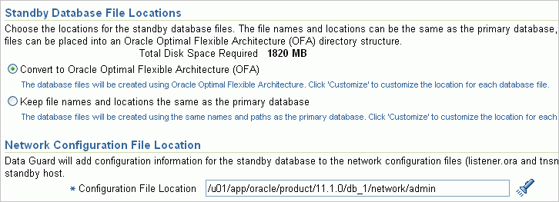
Step 4: Specify the Standby Database
File Locations
Notes:
Oracle Database 11g: Data Guard Administration 5 - <number>
Step 4: Specify the Standby Database File Locations
By default, all standby database files are placed in an Oracle Optimal Flexible Architecture (OFA) directory structure when your primary and standby databases are on the same host.
When your primary and standby databases are on different hosts, you can specify that you want to convert the standby files to an OFA structure or keep the file names and locations the same as the primary database. As an option, you can change the locations of individual standby database files by clicking the Customize button to display the File Locations Customize page of the wizard.
Data Guard automatically adds configuration information for the new standby database to the listener.ora and tnsnames.ora files in the directory that is specified in the Configuration File Location field in the Network Configuration File Location section. The default location is the network administration directory for the standby database’s Oracle home. The default location is correct for most configurations. You can specify a different directory if you want the new standby database to be serviced by a listener that is running in a different Oracle home on the standby host.

Slide 14
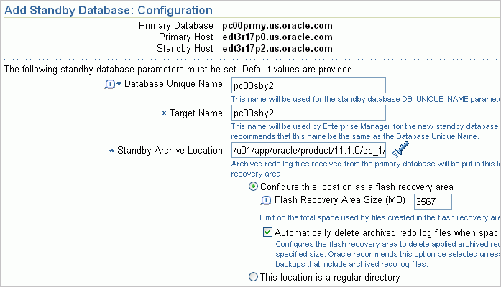
Step 5: Specify Standby Database
Configuration Parameters
Notes:
Oracle Database 11g: Data Guard Administration 5 - <number>
Step 5: Specify Standby Database Configuration Parameters
On the Standby Configuration page, you can specify configuration parameters for the standby database. The parameters that must be specified depend on whether you are adding an existing standby database, creating a physical standby database, or creating a logical standby database. The configuration parameters include the instance name, service provider name, target name, and standby archive location. The default values are based on corresponding primary database settings.
When you create a physical database, you must configure the following parameters:
Database Unique Name: Specify a value for the database DB_UNIQUE_NAME parameter. This name must be unique in the Data Guard configuration.
Note: This field appears only if you are creating a physical standby database.
Target Name: Specify a name for Enterprise Manager to use for the new standby database. This name will appear in the list of database targets maintained by Enterprise Manager. This name should be the same as the database unique name.

Slide 15
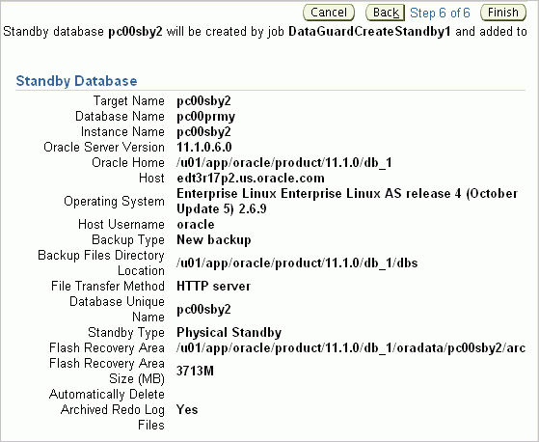
Step 6: Review the
Configuration Information
Notes:
Oracle Database 11g: Data Guard Administration 5 - <number>
Step 6: Review the Configuration Information
The Review page displays a summary of your selections and lists the parameters to be used to create the standby database.
The standby database is created in the background by an Oracle Enterprise Manager job. The name of the job that is submitted is provided at the top of the page.
When you click Finish, the Processing page appears. This page tracks each step through the submission of the standby creation job. After the job submission is complete, you see the Data Guard Overview page, where you can monitor the progress of the standby creation job.

Slide 16
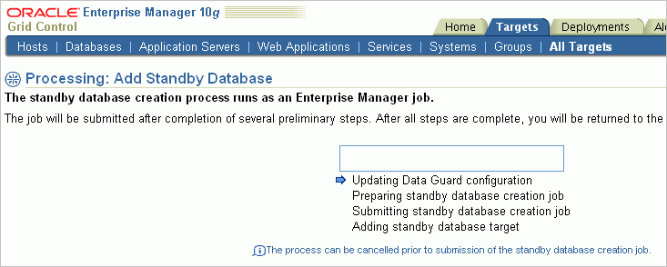
Standby Database Creation: Processing
Notes:
Oracle Database 11g: Data Guard Administration 5 - <number>
Standby Database Creation: Processing
On the Processing page, you can view the progress of the Add Standby Database process. On completion of the process, Oracle Enterprise Manager displays the Data Guard Overview page.
The display on the Processing page differs based on whether you are adding an existing standby database or creating a standby database. An arrow indicates which step is being processed. When the process is completed, a check icon appears next to the step.
The following steps appear on the Processing page:
Creating Data Guard Configuration or Updating Data Guard Configuration: The Data Guard configuration (if it does not exist) is created during this step. If you are adding an existing standby database, it is added to the configuration.
Preparing standby creation job: This step appears only if you are creating a standby database. The standby database is actually created by an Enterprise Manager job; preliminary setup steps to prepare for job submission are accomplished in this step. You can cancel the Add Standby Database process at any point up to the completion of this step.

Slide 17
Notes:
Standby Database Creation: Processing (continued)
Submitting standby creation job: This step appears only if you are creating a standby database. The Enterprise Manager job that creates the standby database in the background is submitted in this step. The Add Standby Database process cannot be canceled after this step begins.
Adding standby database target: In this step, the standby database target in Enterprise Manager is updated with additional information indicating membership in the Data Guard configuration. This enables enhanced summary information to be displayed on the Enterprise Manager home page of the standby database.

Slide 18
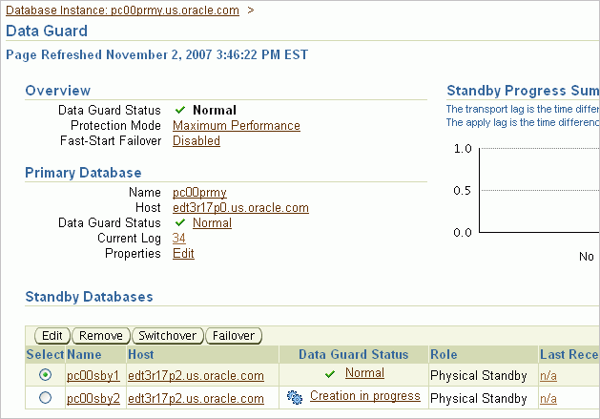
Standby Database Creation: Progress
Click “Creation in progress” to view the job.
Notes:
Oracle Database 11g: Data Guard Administration 5 - <number>
Standby Database Creation: Progress
After the job is submitted, you return to the Data Guard Overview page. The Data Guard Status column indicates that standby database creation is in progress. Click the “Creation in progress” link to access the job page and monitor the progress.
After creation of the standby database, it appears on the Data Guard Overview page with a status of Normal.

Slide 19

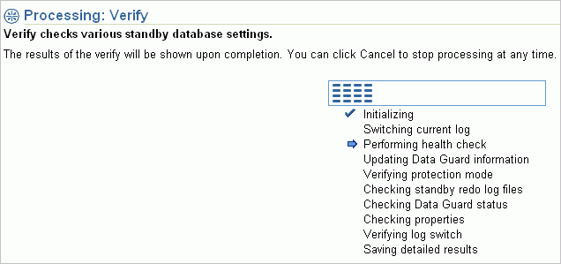
Verifying a Data Guard Configuration
Click the Verify Configuration link.
Notes:
Oracle Database 11g: Data Guard Administration 5 - <number>
Verifying a Data Guard Configuration
After creating your configuration, you should use the Data Guard Verify operation to check the configuration. (You can use the Verify operation at any other time to check your configuration.) Invoke the Verify operation by clicking Verify Configuration in the Additional Administration section of the Data Guard page. The Verify operation performs a series of validation checks on the Data Guard configuration, including a health check of each database and agent.
The Verify operation:
Determines the current data protection mode settings, including the current redo transport mode settings for each database and whether the standby redo logs are configured properly. If standby redo logs are needed for a database, a message indicates this on the Detailed Results page. You can then add the standby redo logs.
Validates each database for the current status.
Performs a log switch on the primary database (for non-RAC databases) and verifies that the log was applied on each standby database.
Checks the agent status for each database. The verify process executes a SQL*Plus job on the agent if credentials are available. If credentials are not available to run the job, the agent is pinged instead. If errors occur, a message appears on the Detailed Results page.
Displays the results of the Verify operation (including errors).
Note: You can cancel the Verify operation at any time by clicking Cancel.

Slide 20
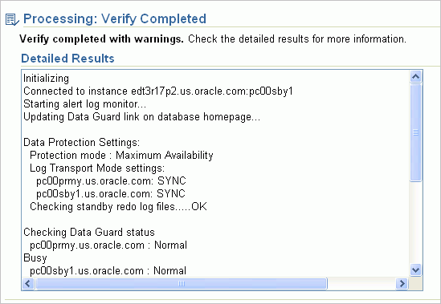
Reviewing Results of the Verify Operation
Notes:
Oracle Database 11g: Data Guard Administration 5 - <number>
Reviewing Results of the Verify Operation
View the results of the Verify operation on the Detailed Results page. If errors occur during the operation, detailed information appears on this page.

Slide 21
Performing Routine Maintenance
Use Enterprise Manager Grid Control to:
  Change the properties of a database
  Manage apply services
  Set the redo transport mode
Notes:
Performing Routine Maintenance
You can use Enterprise Manager Grid Control to maintain your broker configuration. Each task is described in detail in the next few slides.

Slide 22
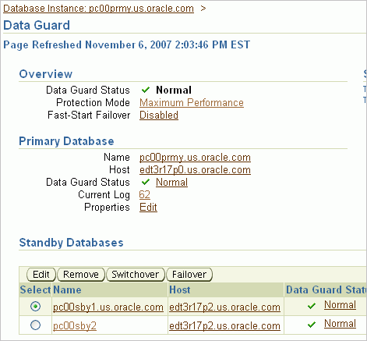
Editing Standby Database Properties
Click Edit to access the
Edit Standby Database Properties page.
Notes:
Editing Standby Database Properties
To access the Standby Database Properties page, select your standby database on the Data Guard overview page and click Edit.

Slide 23
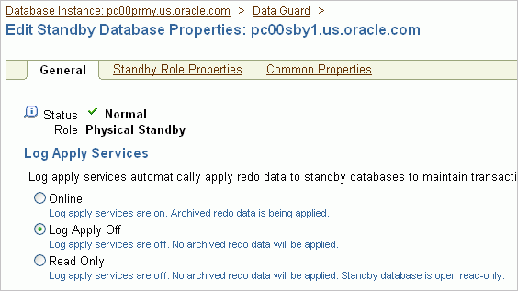
Managing Apply Services
Notes:
Managing Apply Services
You may need to temporarily stop Redo Apply for routine maintenance tasks. You can stop apply services by selecting Log Apply Off on the Edit Standby Database Properties page and then clicking Apply.
When you specify Log Apply Off, Redo Apply is stopped and redo data is not applied to the standby database. However, the standby database continues to receive data from the primary database.

Slide 24
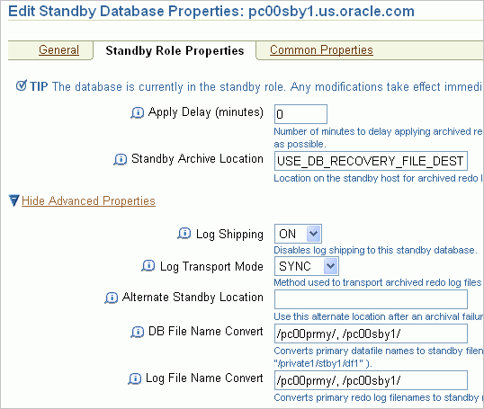
Changing the Properties of a Database
Notes:
Changing the Properties of a Database
To use Enterprise Manager to view or change properties:
1. In the Primary Database section on the Data Guard Overview page (or in the Standby Databases section, as appropriate), click Edit.
2. Click the Standby Role Properties tab or the Common Properties tab (depending on the property that you want to change).
3. Make the appropriate change and click Apply.
When the process is completed, a message indicates success.

Slide 25
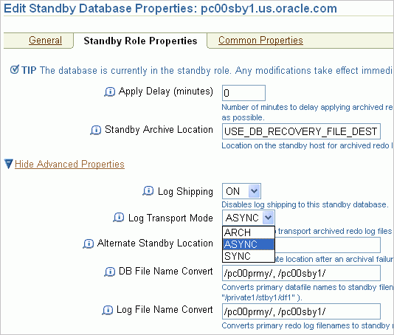
Setting the Redo Transport Mode by Using Enterprise Manager
Select the mode from
the Log Transport Mode list.
Notes:
Setting the Redo Transport Mode by Using Enterprise Manager
On the Standby Role Properties page, select the redo transport mode from the following values in the Log Transport Mode list:
ARCH: Configures redo transport services for your standby database by using the ARCH attribute of the LOG_ARCHIVE_DEST_n initialization parameter. You do not need standby redo log files for this mode. This mode provides the lowest level of protection to the primary database and incurs the lowest performance impact.
Note: ARCH is deprecated in Oracle Database 11g but still appears in Enterprise Manager Grid Control 10g.
ASYNC: Configures redo transport services for your standby database by using the LGWR, ASYNC, and NOAFFIRM attributes of the LOG_ARCHIVE_DEST_n initialization parameter. This mode, along with standby redo log files, provides a moderate level of protection to the primary database and incurs a moderate performance impact.
SYNC: Configures redo transport services for your standby database by using the LGWR, SYNC, and AFFIRM attributes of the LOG_ARCHIVE_DEST_n initialization parameter. This mode, along with standby redo log files, is required for the maximum-protection or maximum-availability protection modes. This redo transport mode provides the highest level of data protection to the primary database, but it also incurs the highest performance impact.

Slide 26
Summary
In this lesson, you should have learned how to:
  Use Enterprise Manager to create a configuration
  Use Enterprise Manager to monitor the configuration

Slide 27
Practice 5: Overview
This practice covers the following topics:
  Installing the Oracle Management Agent
  Logging in to Oracle Enterprise Manager 10g
  Grid Control
  Setting monitoring credentials
  Adding a physical standby database to your broker configuration by using Enterprise Manager Grid Control
  Deleting the newly created physical standby database

